Slide 1
Mapping Categorical and Dimensional Attributes from Text to Sentiment Scores
Saahil Singh
Mentor: Dr. Sarala Padi
Notes:
Good morning, everyone, my name is Saahil and today I will be presenting my research on mapping categorical and dimensional attributes from text to sentiment scores. This project has been guided by my mentor Dr. Sarala Padi.

Slide 2
Outline
Introduction
Emotion Recognition
Sentiment Analysis
Applications
Methods to generate sentiment
Hard thresholding
Limitations
Proposed Method
Clustering
Transfer Learning
Manual
Datasets
IEMOCAP
MELD
Results
Metrics
Accuracy
F1-Score
Conclusions
Labeling

Slide 3
Emotion Recognition and Sentiment Analysis
Emotion Recognition is a means of identifying distinct human emotions
Healthcare, Education
Sentiment Analysis is the process of categorizing data as positive, negative, or neutral
Interpreting Reviews, Enhance Emotion Recognition Models
Modalities: text, audio, visual, hand gestures, etc.
Notes:
Emotion recognition is a means of identifying distinct human emotions
While Sentiment analysis is the process of categorizing data as positive, negative, or neutral
ER: Healthcare, Education
SA: Interpreting Reviews, Enhance Emotion Recognition Models
Algorithms that do both these things can look at different modalities of data
Text, Audio, Visual, Hand gestures, and more
Focused on text data which can be labeled into three different attributes that we will look at

Slide 4
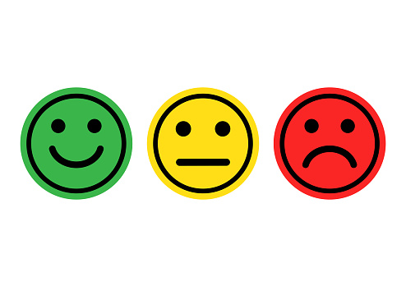
Sentimental Attributes
Categorization of the content as positive, negative, or neutral
Difficult to examine due to ambiguity and sarcasm
Ambiguous Examples
That’s just what I needed today!
This story is excellent to put you to sleep!
Ref: [ 2 ]
Notes:
The first is sentimental attributes, so like I said earlier sentimental attributes are labeling data as positive, negative, or neutral
One challenge that comes with this is being able to identify the correct sentiment when the content is ambiguous or sarcastic.
For example, “That’s just what I needed today!” could be positive or negative if it is sarcastic.
Another example, “This story is excellent to put you to sleep!”
Contains the word excellent but does not have positive sentiment

Slide 5
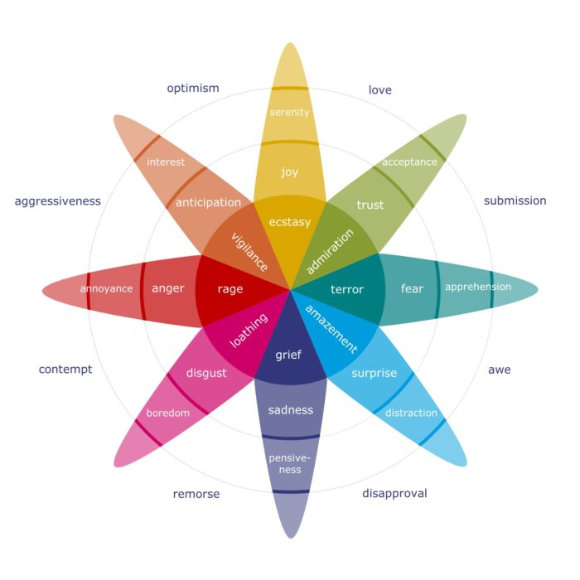
Categorical Emotions
Paul Ekman’s 6: Anger, Disgust, Fear, Happiness, Sadness, and Surprise
Plutchik’s wheel of emotions
State-of-the-art focuses on 4 core emotions
Angry
Sad
Happy
Neutral
Ref: [ 7 ]
Notes:
Next attribute is Categorical emotions which is the standard way we label our own emotions
Different models for this attribute
Paul Ekman’s 6
Plutchik’s wheel of emotions
State-of-the-art focuses on 4 core emotions Angry, Sad, Happy, Neutral

Slide 6
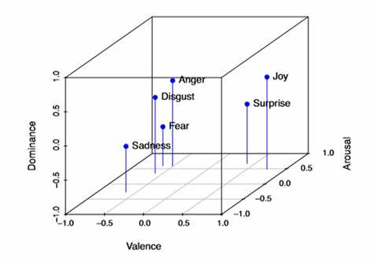
Dimensional Attributes
Representation of emotions through valence, arousal, and dominance
Valence
positivity & negativity
Arousal
intensity
Dominance
degree of control
Ref: [ 8 ]
Notes:
The last attribute is dimensional and this involves representing emotions with a value for 3 categories
Continuous
Valence which is positive and negativity
Arousal which is the intensity
Dominance which is the degree of control the emotion exhibits

Slide 7
Problem Definition
Hard Thresholding [Neumann et. al]
Analysis limited to valence and arousal [Verma et. al]
Inconsistencies in mapping across datasets [Schuller et.al]
Neutral labeled inconsistently
Emotions like surprise can be positive or negative
 | Low/Negative | High/Positive
IEMOCAP | Range [1, 2.5] | Range (2.5, 5]
Recola | Range [-1, 0] | Range (0, 1]
Arousal | Low | High
AVIC | Boredom | Neutral, Joyful
DES | Neutral sadness | Anger, happiness, surprise
Valence | Negative | Positive
MELD | Anger, Disgust, Fear, Surprise, Sadness | Joy, Surprise
Notes:
With this information we can look at the two problems we are exploring
Firstly, state of the art does hard thresholding to determine sentiment
IEMOCAP example on the right
Neglects neutral and does not include dominance factor which we believe may have a role
Secondly, there are many inconsistencies in mapping attributes across datasets
First example, neutral inconsistent label
Surprise ambiguity

Slide 8
Goals of project
Build and evaluate models that can effectively transition categorical and dimensional attributes to sentiment labels
Address any inaccuracies or discrepancies in traditional methods
Ultimately enhance understanding of how to create an emotion recognition model from text data
Notes:
The goal of this project is to build and evaluate models and mapping techniques that can effectively transition categorical and dimensional attributes to sentiment labels
Address any inaccuracies or discrepancies in traditional methods
Ultimately enhance our understanding of how to create an emotion recognition model from text data

Slide 9
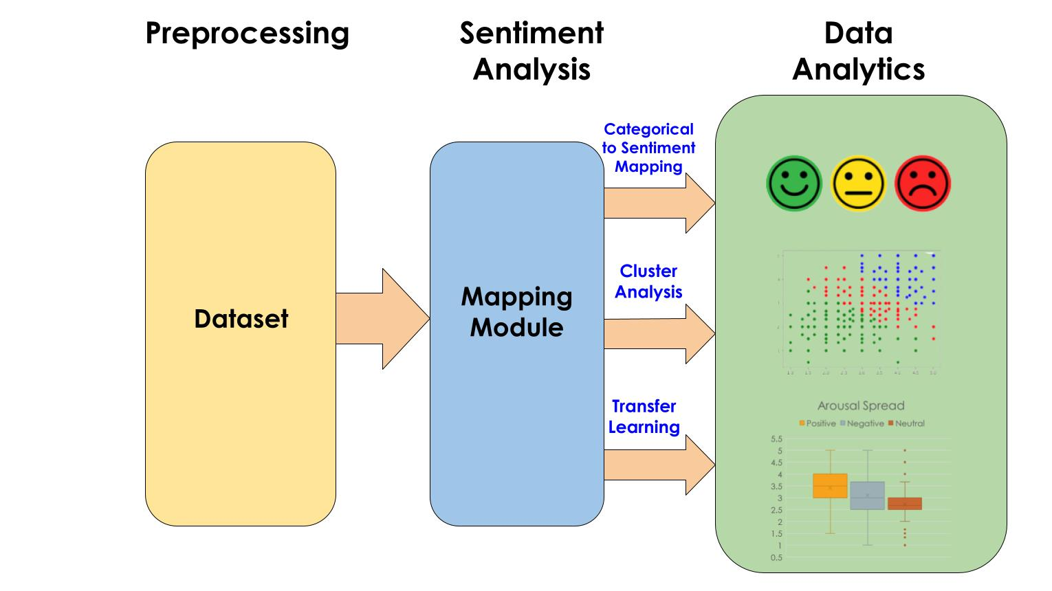
Notes:
Here is an outline of my research split up into three steps.
First is preprocessing and understanding our dataset
Second is taking the data and conducting sentiment analysis with three methods
Lastly, analyzing the result of our sentiment analysis with each method

Slide 10
What is the iemocap dataset?
Interactive Emotional Dyadic Motion Capture
Includes text, audio, and visuals for dialogue between two speakers
Utterances labeled with categorical and dimensional values
Notes:
Interactive Emotional Dyadic Motion Capture
Includes text, audio, and visuals for dialogue between two speakers
Utterances labeled with categorical and dimensional values

Slide 11
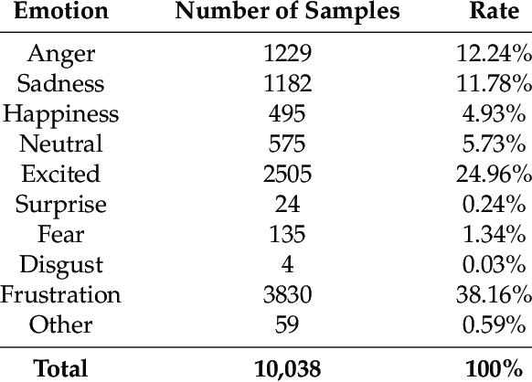
IEMOCAP DATASET STATISTICS
Original
10,038 Samples
9 Categorical Labels
(anger, sadness, excited, happy, neutral, fear, frustrated, surprise, disgust)
We are working with 5 labels
5,531 samples
Ref: [ 5 ]
Notes:
Original
10,038 Samples
9 Categorical Labels
(anger, sadness, excited, happy, neutral, fear, frustrated, surprise, disgust)
We are working with 5 labels
5,531 samples

Slide 12
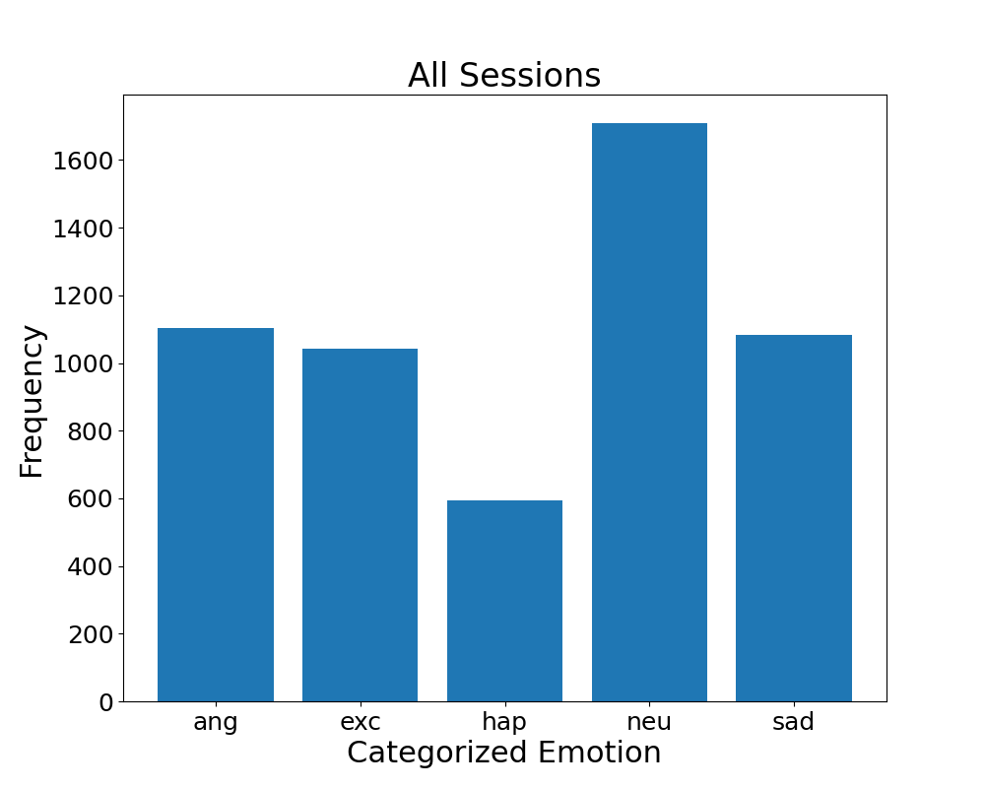
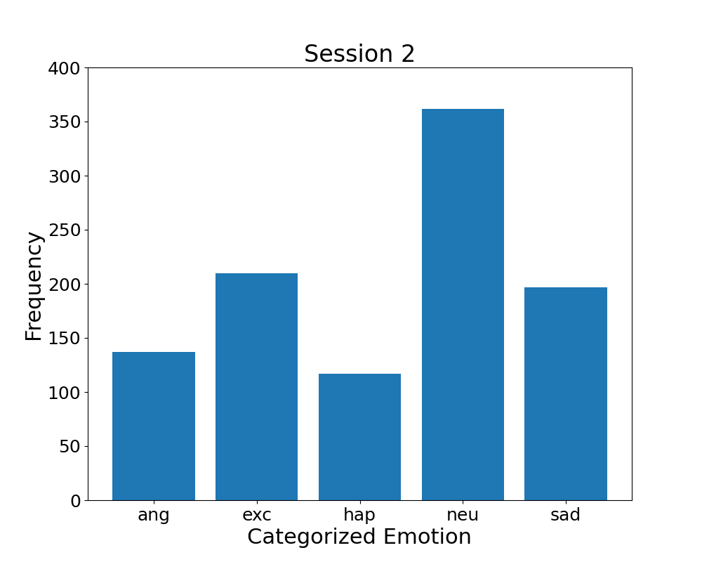
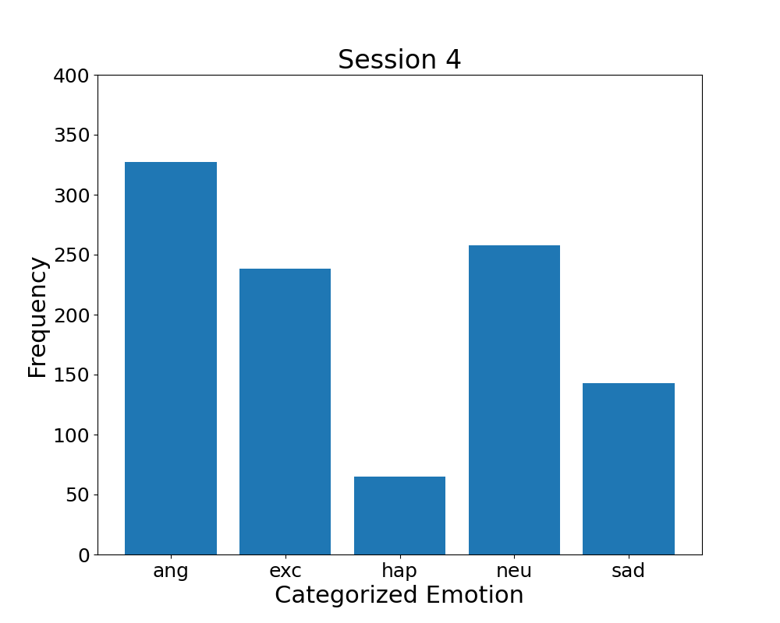
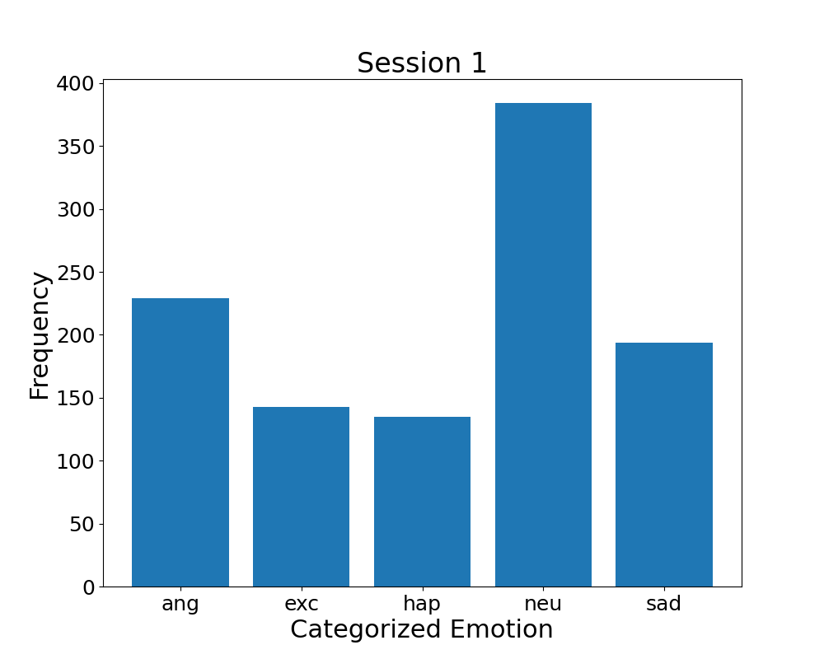
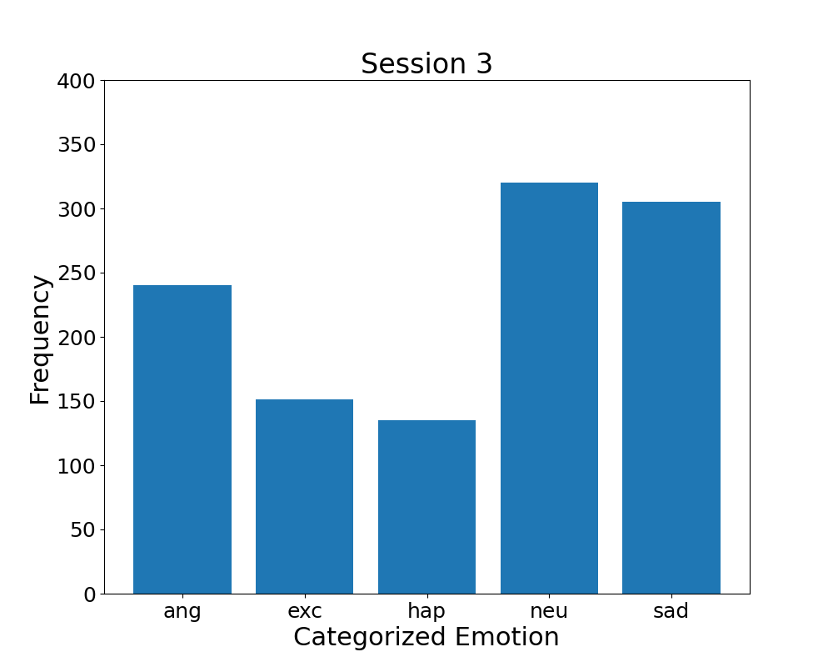
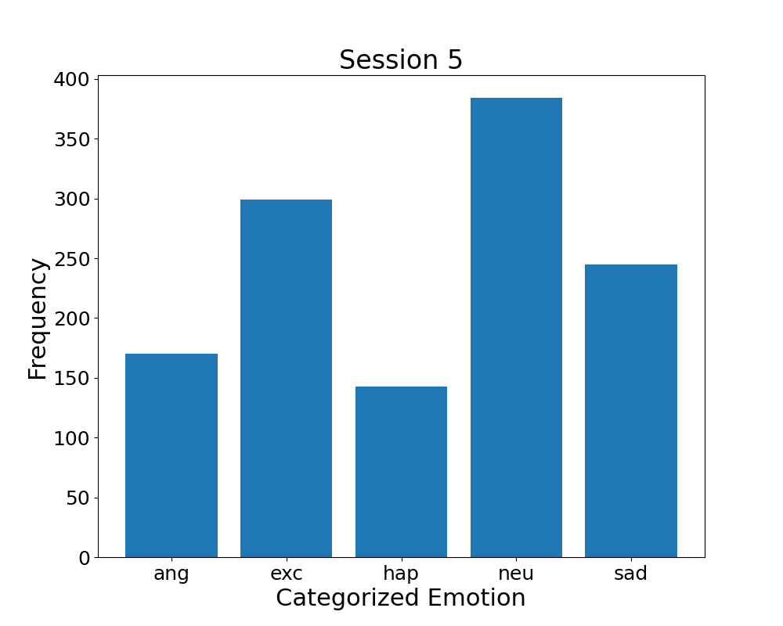
Iemocap Emotion Distribution
Notes:
The IEMOCAP dataset is divided into 5 sessions and here we have plotted the frequency of each emotion for each session and combined
Data imbalance (angry and neutral are most frequent, happiness lacks datapoints)
To handle the imbalance we chose to use a transfer learning model which we will talk about more in depth later.

Slide 13
Notes:
Now we are going to look into our first mapping method, categorical to sentiment mapping

Slide 14
Categorical To Sentiment mapping
[ang, exc, hap, neu, sad]
Negative
Angry
Sad
Positive
Happy
Excited
Neutral
Neutral
Notes:
This method is straight forward and involved taking the categorical emotion labels for each utterance and gives it a sentiment based on a set mapping which is outlined here
If the text is labeled as angry or sad we assign it negative sentiment, neutral label is assigned neutral sentiment, and happy and excited are assigned positive
We are going to call this manual mapping for short

Slide 15
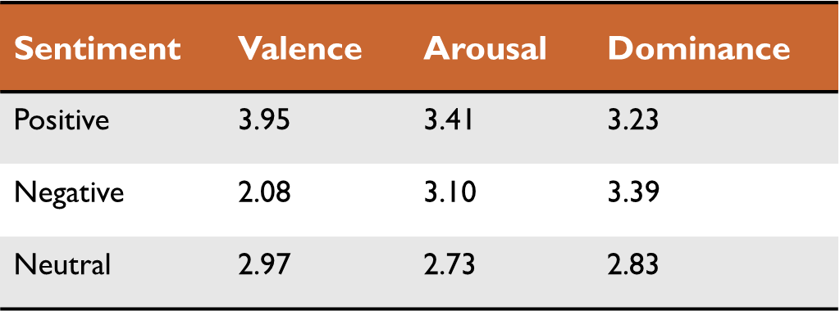
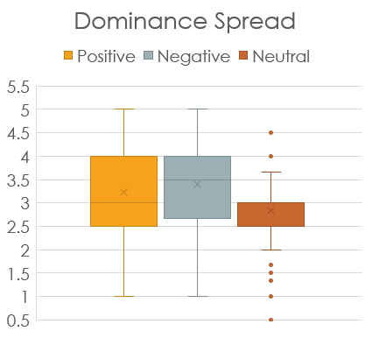
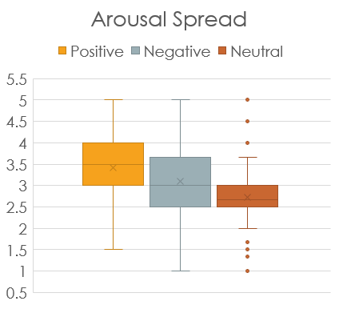
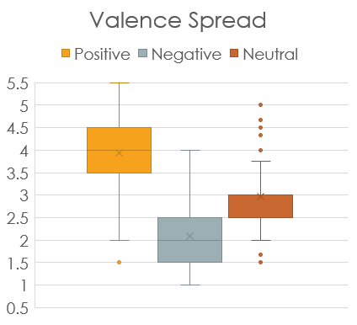
Categorical Results
Notes:
Taking these generated sentiment scores, we looked at the attached valence, arousal, and dominance values to see the distinction between positive, negative, and neutral
For valence, the distinction between positive, negative, and neutral is clear
For arousal, we can observe that positive on average exhibits the most intensity over negative and then neutral
Lastly, for dominance, Negative sentiment has more dominance than positive and neutral. However, positive and negative are comparable
Both these observations make sense as neutral emotions should exhibit less intensity and less dominance
The below table shows the mean threshold for each sentiment

Slide 16
Notes:
We are now going to move on to the second mapping method which is cluster analysis

Slide 17
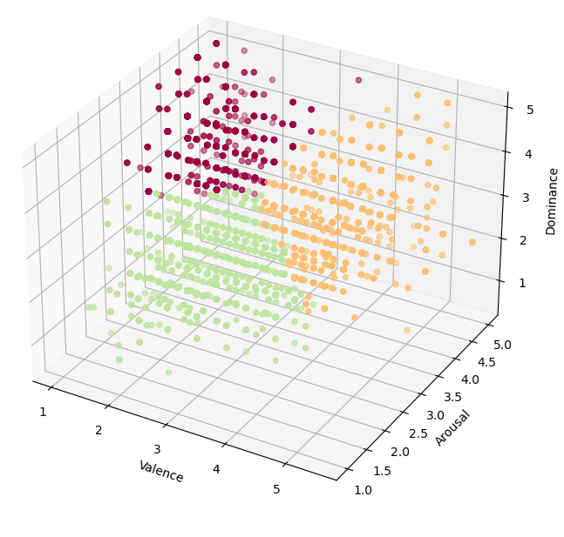
K-Means Cluster Analysis
Unsupervised learning method
K-Means method with k = 3
Algorithm ran over dimensional data for all data points
Generates centroid for each cluster
Notes:
The specific method used for our cluster analysis is called K-Means cluster analysis
It is an unsupervised learning model so it does not depend on any ground truth
The algorithm computes cluster centroids based on the Euclidean distance between centroids and datapoints.
With each calculation it finds a new location for the centroid and its surrounding points for the cluster
This is done for a couple hundred iterations until a final centroid is determined.
We ran this method over dimensional attributes with k = 3 since we have 3 clusters we are looking for positive, negative, and neutral

Slide 18
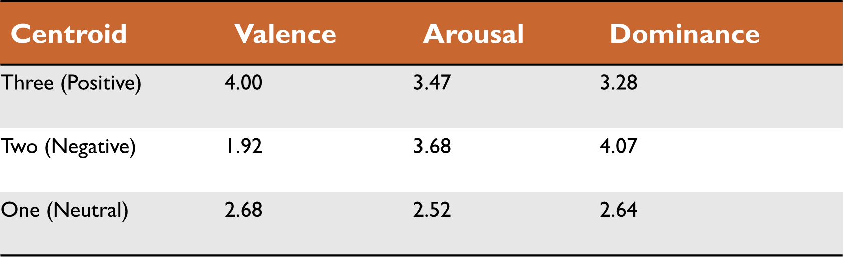
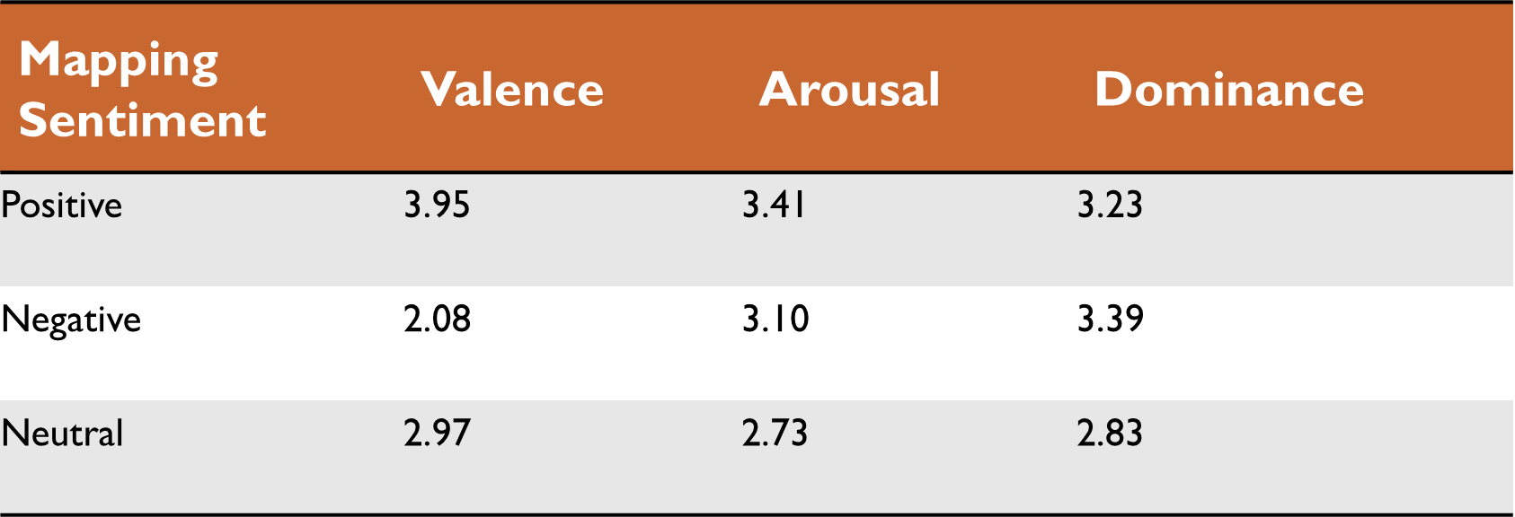
Cluster Results
Notes:
Here are the exact centroid positions for the previous plot
Valence shows large gap between positive and negative similar to manual mapping
Arousal values are comparable, but most importantly the neutral arousal value is the lowest
For the dominance values, the negative dominance is much larger than positive with neutral the lowest again
So our cluster analysis is consistent with manual mapping

Slide 19
Notes:
Moving on to the third mapping method, transfer learning

Slide 20
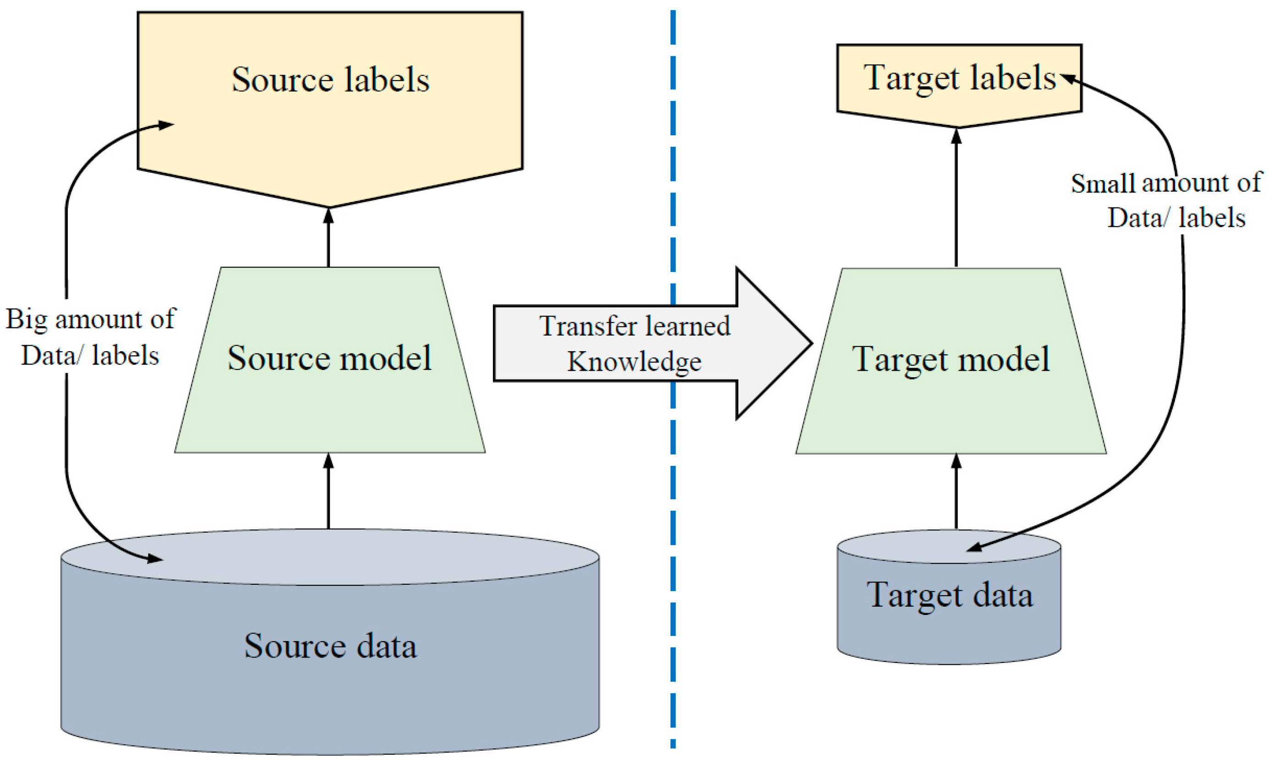
Transfer learning
Addresses data imbalance and lack of data for model building
Pretrained transformer-based (RoBERTa) model pulled from Hugging Face
Ref: [ 1 ]
Notes:
As I mentioned earlier, we are using transfer learning to address the data imbalance
Transfer learning is the process of training a model on a larger amount of data and then transferring the knowledge to our target data and then finetuning
Here we have used a transformer-based pretrained model for our sentiment analysis
This RoBERTa model was pulled from Hugging face, and is a state-of-the-art model we have seen used across papers

Slide 21
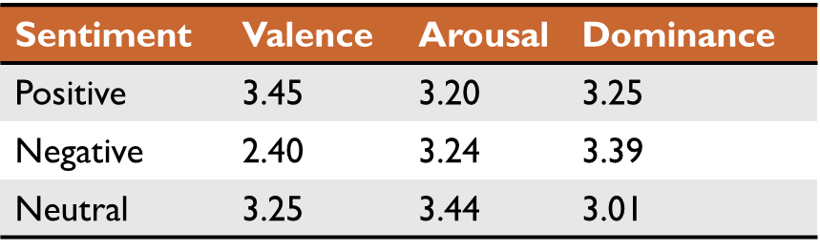
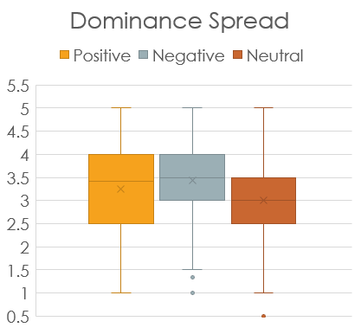
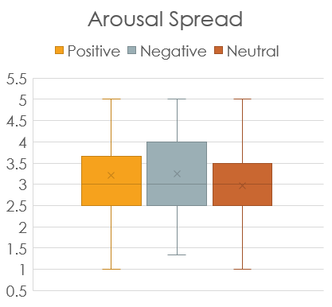
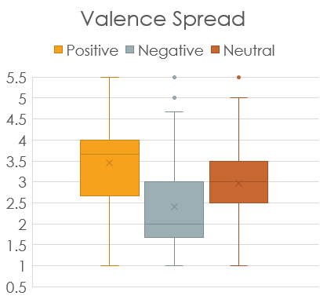
Transfer learning
Notes:
Here we can see that our model did not generate the most accurate sentiment scores as Positive, negative, and neutral are hard to distinguish among valence values
Furthermore, the thresholds from this model overlap across sentiments, so it is difficult to make any conclusions

Slide 22
IEMOCAP Results
Method | Sentiment | Valence | Arousal | Dominance
Categorical | Positive | 3.95 | 3.41 | 3.23
TL | Positive | 3.45 | 3.20 | 3.25
Clustering | Positive | 4.00 | 3.47 | 3.28
Categorical | Negative | 2.08 | 3.10 | 3.39
TL | Negative | 2.40 | 3.24 | 3.39
Clustering | Negative | 1.92 | 3.68 | 4.07
Categorical | Neutral | 2.97 | 2.73 | 2.83
TL | Neutral | 3.25 | 3.44 | 3.01
Clustering | Neutral | 2.68 | 2.52 | 2.64
Evaluated 3 types of mapping methods
Categorical to Sentiment
Cluster Analysis
Transfer Learning
Analyzed dimensional attributes and found the following thresholds
Categorical and Cluster method consistent
TL: Transfer Learning
Notes:
Evaluated 3 types of mapping methods
Categorical to Sentiment
Cluster Analysis
Transfer Learning
Analyzed dimensional attributes and found the following thresholds
Categorical and Cluster method consistent
Maybe delete if not enough time

Slide 23
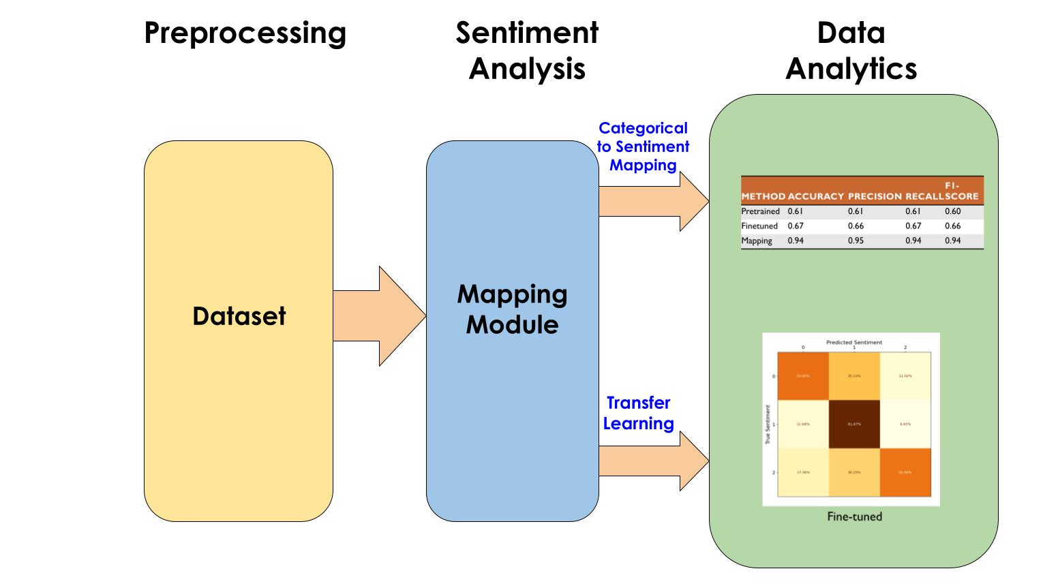
Notes:
We extended our analysis on mapping to another benchmark dataset called MELD
The big difference between the MELD and IEMOCAP dataset is that MELD contains sentiment scores for each utterance but no dimensional attributes.
Hence, we evaluated two methods
Categorical to sentiment
Transfer Learning

Slide 24
MELD DATASET STATISTICS
Train
9,989 Samples
Dev
1,109 Samples
Test
2,610 Samples
Notes:
The dataset is divided into three sets: train, dev, and test
Train is for training the model
Dev is for validating the model while training
Test is for evaluating the final model
As you can see the sets are very neutral heavy, but have a similar distribution of sentiment across each set.

Slide 25
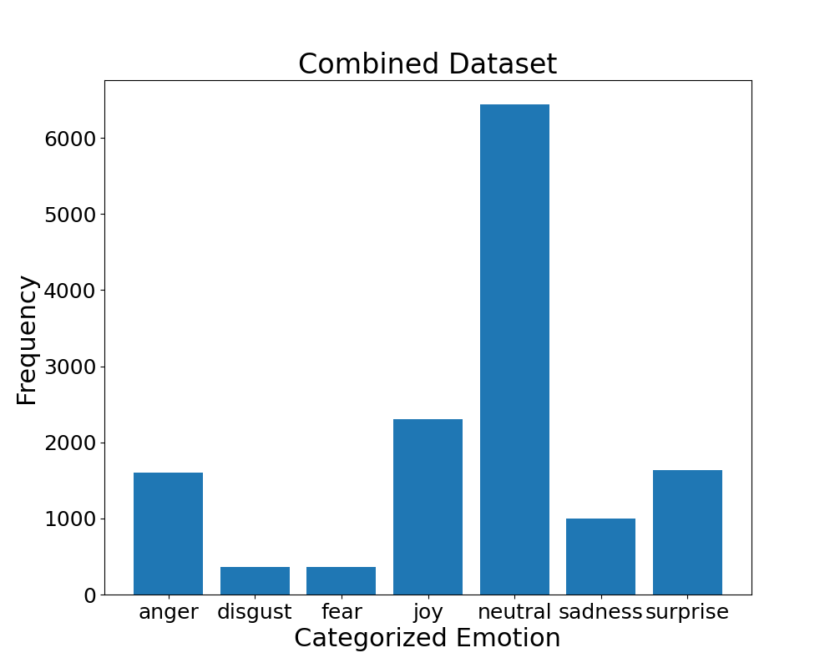
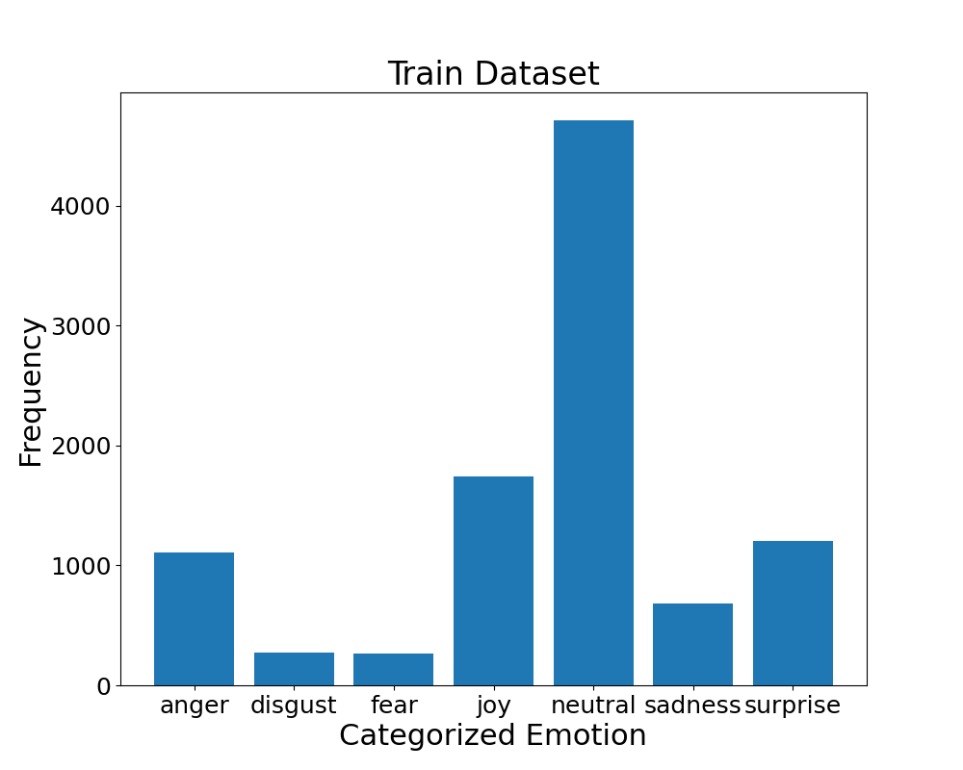
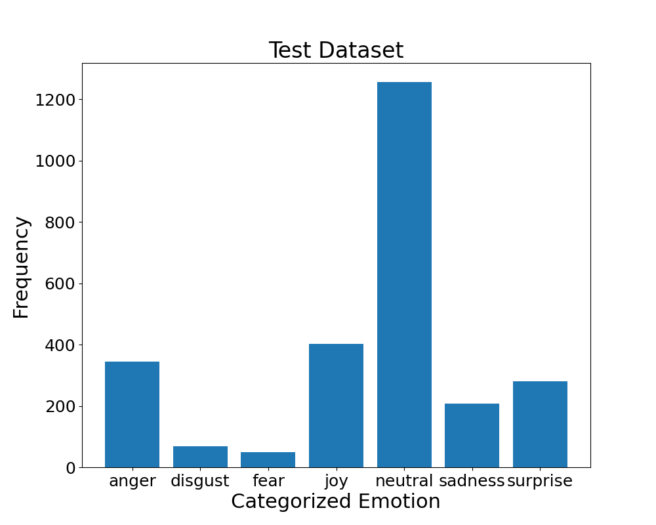
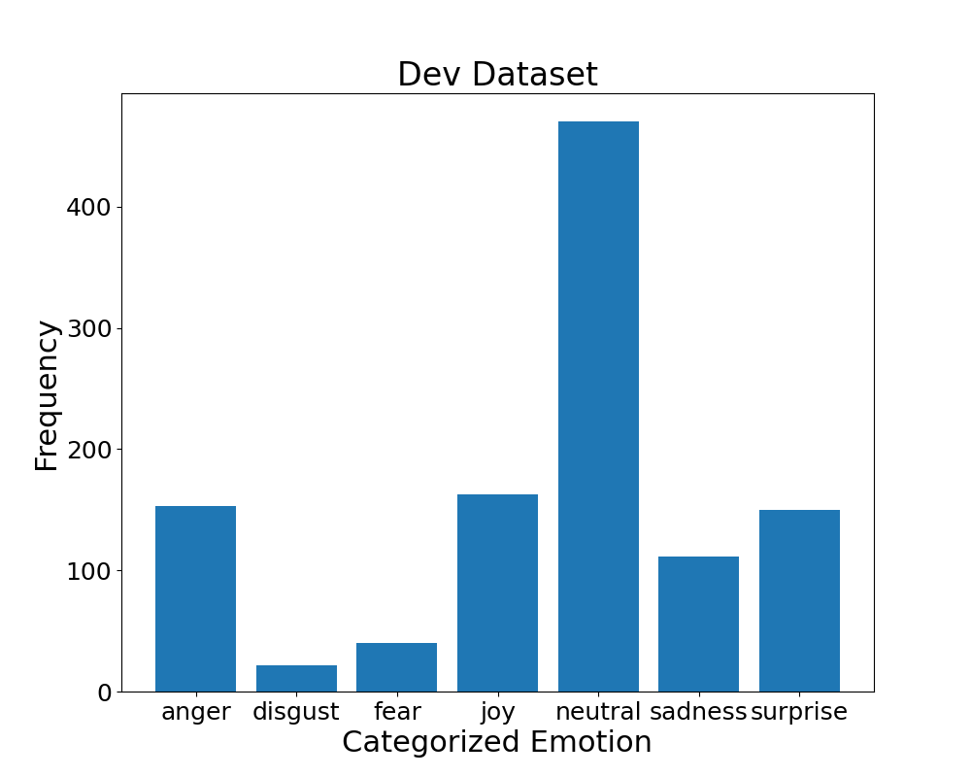
MELD Emotion Distribution
Notes:
Data imbalance
Transfer learning

Slide 26
Transfer learning
Addresses data imbalance and lack of data for model building
Same model used on IEMOCAP (RoBERTa)
Fine-tuned model on Train dataset
Batch size = 128
Epochs = 100
Metric = Accuracy and F1_Score
Notes:
As we mentioned earlier this transfer learning method addresses the data imbalance
It is the same model we used on IEMOCAP, however we have ground truth sentiment data for each sample
So we can finetune our model on the train dataset
We used a batch size of 128 samples and did this for 100 epochs
We used accuracy and f1 score as our metric for training

Slide 27
Categorical To Sentiment mapping
[ang, dis, fea, joy, neu, sad, sur]
Negative
Anger
Disgust
Fear
Sadness
Positive
Joy
Surprise
Neutral
Neutral
Notes:
Similar to what we did with IEMOCAP
We took emotions labeled with anger, disgust, fear, and sad and made them negative
Neutral we set as neutral
Joy and surprise we set as positive

Slide 28
MELD Results
Finetuning improved accuracy by 6.5%
Mapping manually from categorical to sentiment gave 94%
Mistakes due to ambiguity of surprise
Method | Accuracy | precision | recall | f1-score
Pretrained | 0.61 | 0.61 | 0.61 | 0.60
Finetuned | 0.67 | 0.66 | 0.67 | 0.66
Mapping | 0.94 | 0.95 | 0.94 | 0.94
Notes:
We are comparing two methods of mapping
The finetuned model saw a 6.5% improvement with an overall accuracy of 67%
This is still not a great accuracy and may explain why with the IEMOCAP TL analysis we did not see clear distinctions between positive, negative, and neutral
The manual mapping worked better than the finetuned model
However, this may not be generalized to other datasets
Accuracy = (TP + TN)/ (TP + FP + TN + FN)
Precision = TP/ (TP + FP) (Over estimation, false alarm)
Recall = TP/(TP + FN) (Under estimation, mis probability)
F1-Score = 2* [ (precision*recall) / (precision+recall)]

Slide 29
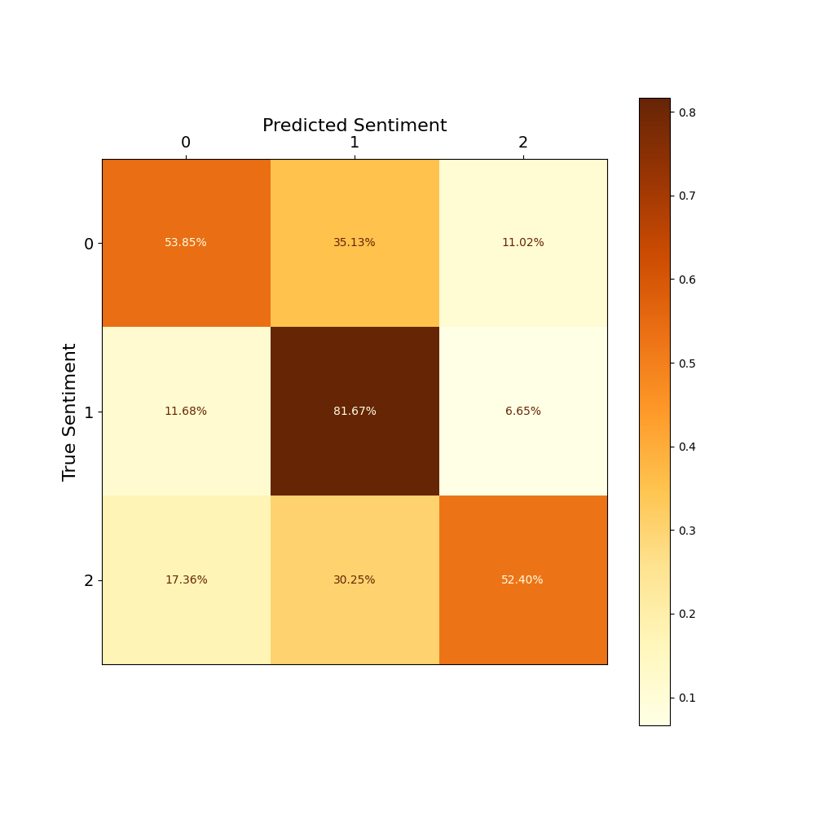
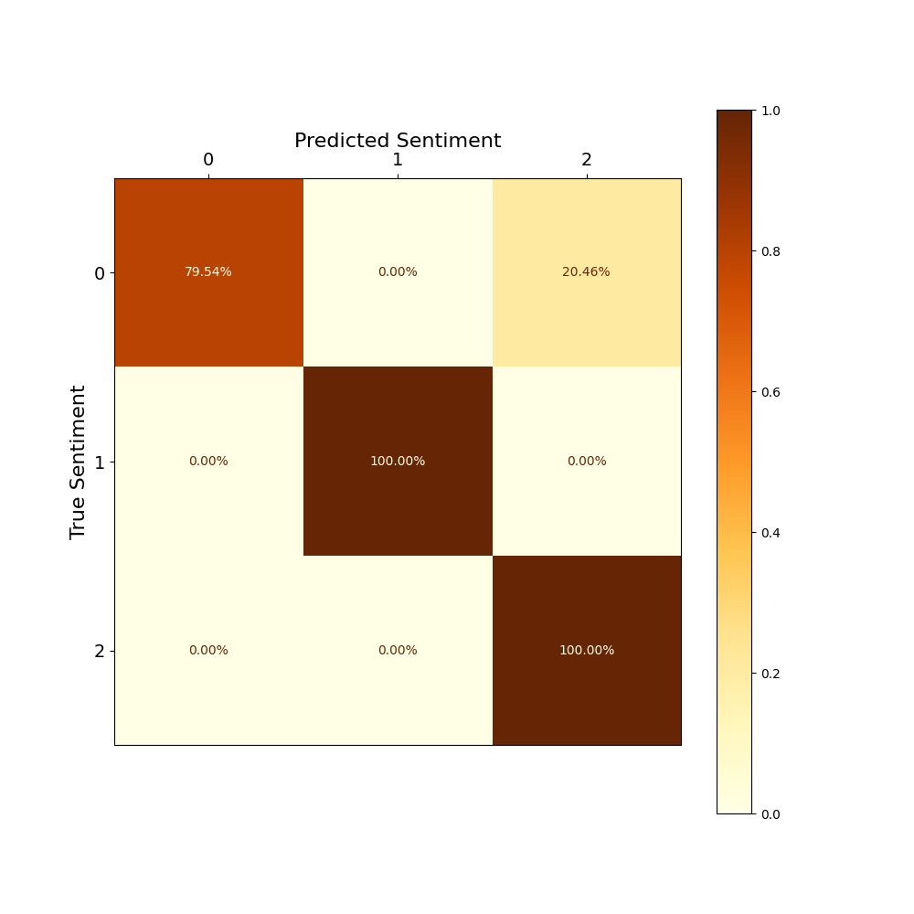
MELD Results
Finetuned:
+ve and -ve sentiments most confused with neutral
Due to model bias?
Categorical to Sentiment:
Method 100% accurate
Except surprise being ambiguous [+ve or –ve]
Fine-tuned
Categorical to Sentiment
0: Negative, 1: Neutral, 2: Positive
Notes:
We also plotted confusion matrices for the fine-tune model and categorical to sentiment mapping method to see how sentiments are confused with each other
In the case of the finetuned model, the positive and negative sentiment scores are more confusable with neutral
With the mapping, only the negative values were confused to be positive
This is because of the ambiguity of surprise

Slide 30
Conclusions
Processed two benchmark datasets
Recognized both are imbalanced
Evaluated three mapping methods for sentiment analysis
Categorical and Clustering methods gave similar results for IEMOCAP
Categorical mapping gave best results for MELD
Transfer Learning method requires more study
Notes:
Manual and Clustering methods gave similar results and helped us to see where the neutral sentiment lies in the dimensional attributes
Categorical mapping gave the most accurate sentiment score predictions with the MELD dataset
Though transfer learning proves to be a useful for many tasks, we were unable to generate accurate sentiment scores so we believe that mapping method requires more study

Slide 31
References
Al-Khafaji, K. S., Al-Jumaily, A., Al-Assam, H., Du, H., & Jassim, S. (2020). Deep Learning Models for Classification of Red Blood Cells in Microscopy Images to Aid in Sickle Cell Anemia Diagnosis. Electronics, 9(3), 427. https://doi.org/10.3390/electronics9030427
iStock. (n.d.). Green yellow red smileys emoticons icon positive neutral and negative [Digital image]. Retrieved June 29, 2023, from Green Yellow Red Smileys Emoticons Icon Positive Neutral And Negative Different Mood Vector Illustration Stock Illustration - Download Image Now - iStock (istockphoto.com)
Jonathan Posner, James A Russell, and Bradley S Peterson,“The circumplex model of affect: An integrative approach to affective neuroscience, cognitive development, and psychopathology,” Development and psychopathology, vol. 17, no. 3, pp. 715–734, 2005.
Neumann, M. (2018, April). Cross-lingual and multilingual speech emotion recognition on english and french. In 2018 IEEE international conference on acoustics, speech and signal processing (ICASSP) (pp. 5769-5773). IEEE.
ResearchGate. (n.d.). Original IEMOCAP dataset structure. Retrieved June 29, 2023, from https://www.researchgate.net/figure/Original-IEMOCAP-dataset-structure_tbl2_328743090
B. Schuller et al., "Cross-corpus acoustic emotion recognition: Variances and strategies (Extended abstract)," 2015 International Conference on Affective Computing and Intelligent Interaction (ACII), Xi'an, China, 2015, pp. 470-476, doi: 10.1109/ACII.2015.7344612.
System Concepts. (n.d.). Plutchik’s wheel of emotion [Digital image]. Retrieved June 29, 2023, from https://www.system-concepts.com/insights/emotion-ai-part-1/plutchiks-wheel-of-emotion-2/
Verma, Gyanendra & Tiwary, Uma Shanker. (2017). Affect Representation and Recognition in 3D Continuous Valence-Arousal-Dominance Space. Multimedia Tools and Applications. 76. 10.1007/s11042-015-3119-y.

Slide 32
Thank You Questions?

Slide 33
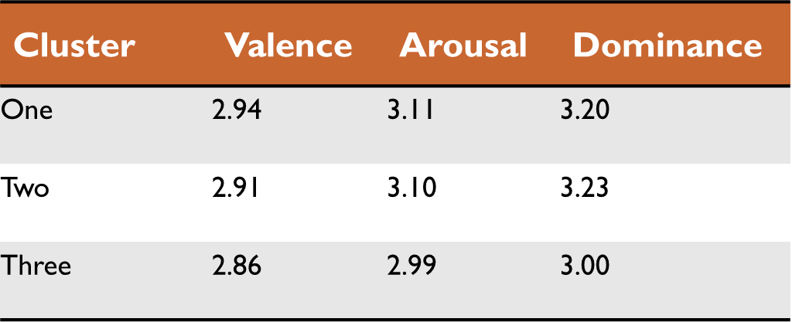
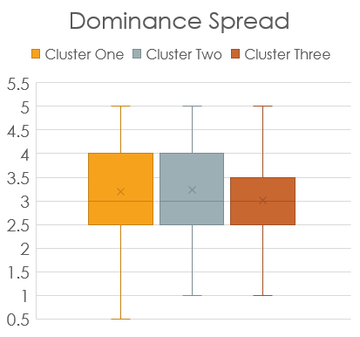
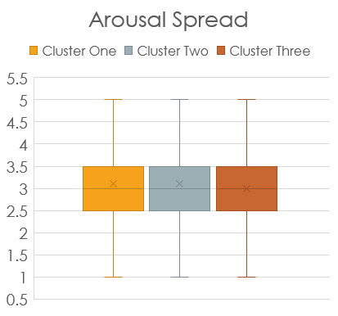
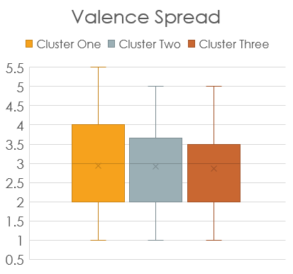
Cluster
Notes:
Talk about plots

